Slide 1
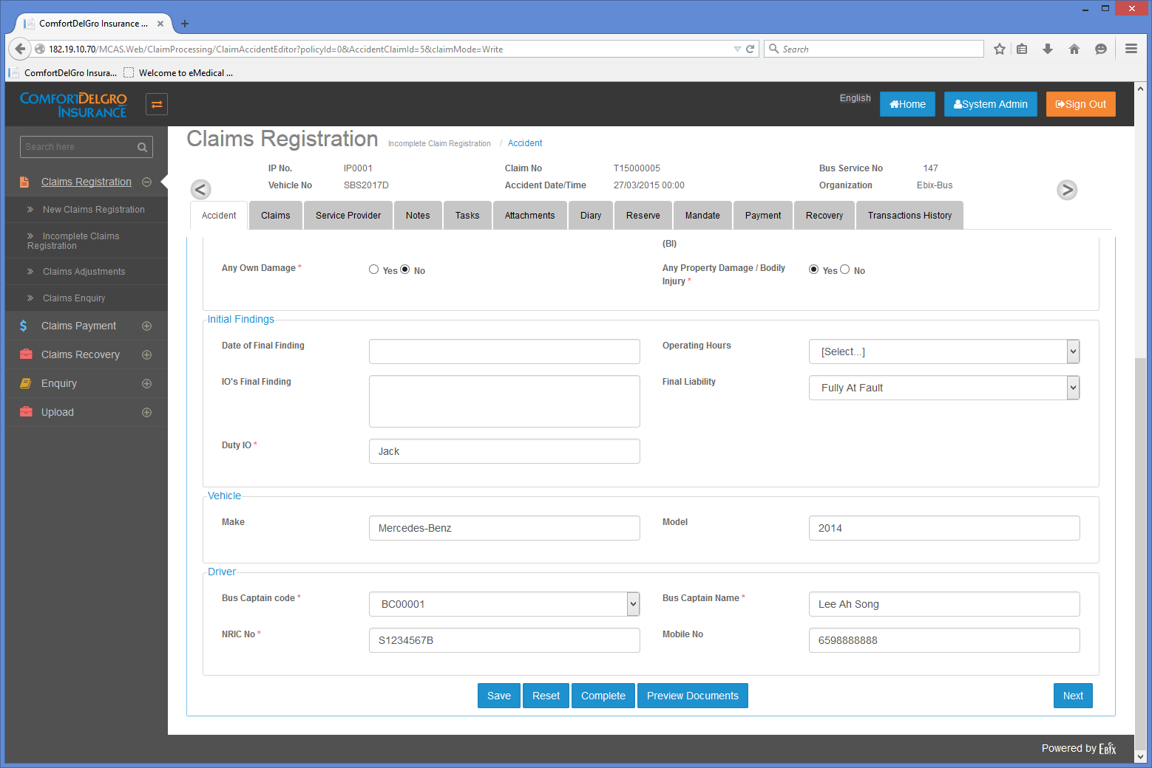
How To Apply For Reserve
Steps:
User needs to create OD, PD or BI Claims in Claims Tab from any Uploaded TAC Claims or Unreported Claims.
Reserve Tab will be opened for editing for Claims in the incomplete claims registration section. Mandate and Payment Tab will not be editable.

Slide 2
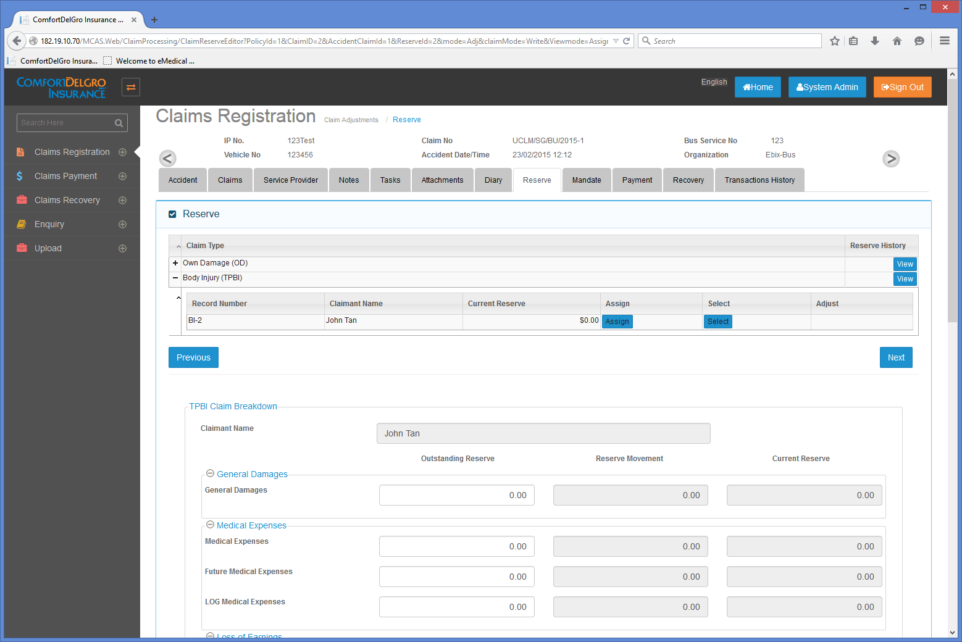
How Reserve Screen Works
Changes Required:
Remove Assign & Adjust Columns
Keep the Select Column and change the Select Button to Edit Button
View Reserve History Button on Individual claim so a new column is to be introduced.
Steps:
Click on the Edit Button and Reserve Fields will appear.
User can input any values in fields
EDIT

Slide 3
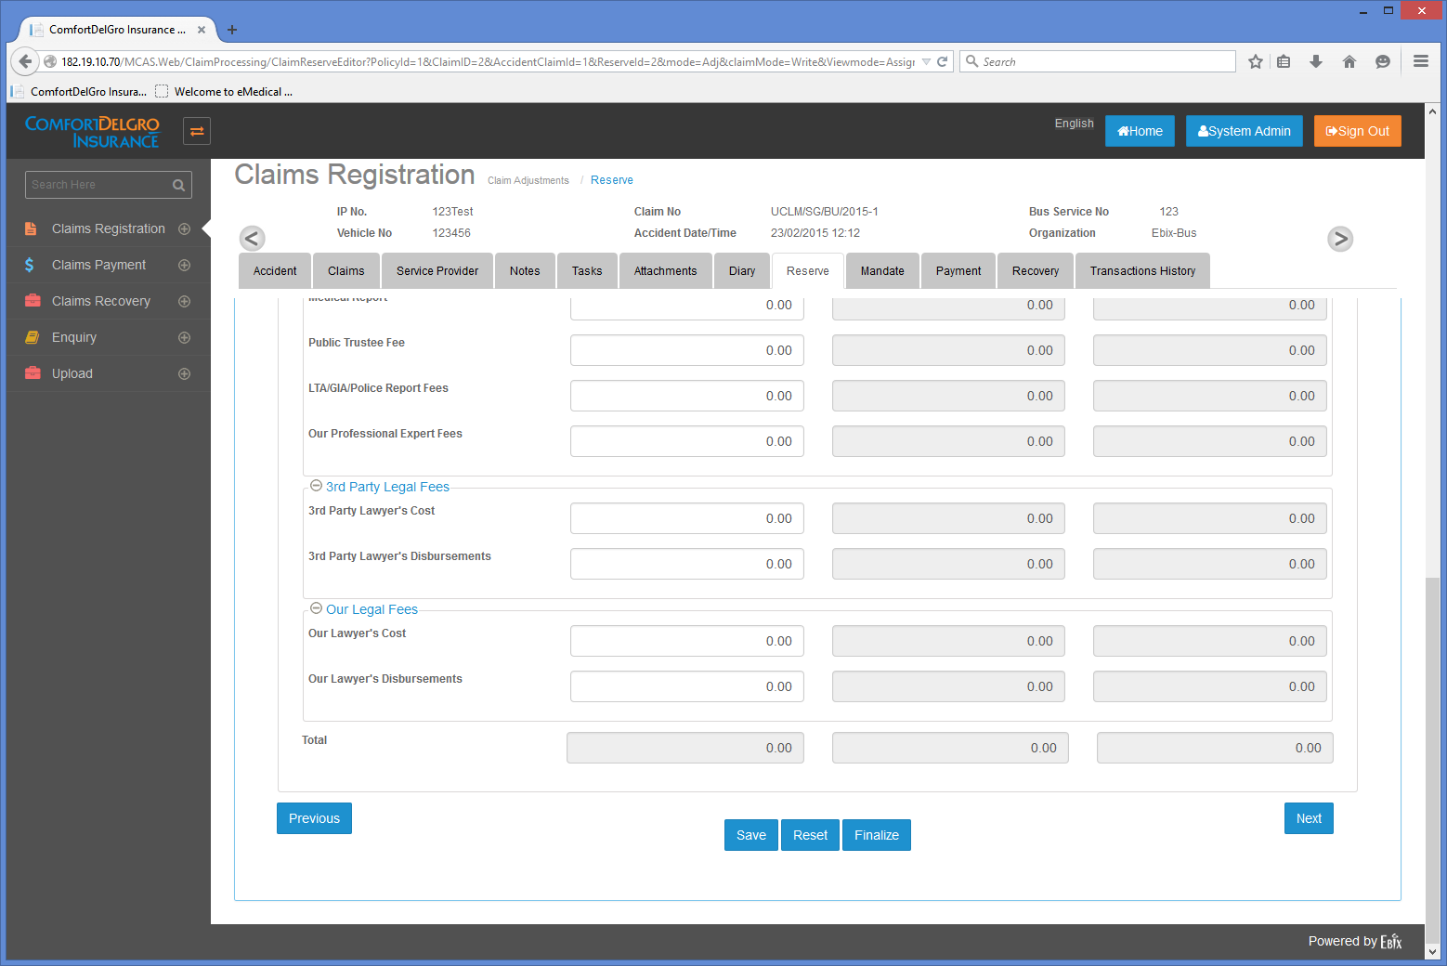
How Reserve Screen Works
Steps:
If User enters $5,000 in Our Lawyer’s Disbursements Field in the Outstanding Reserve Column and Click on Save:
System will block out Our Lawyer’s Disbursements Field in the Outstanding Reserve Column. User cannot edit this field anymore.
Our Lawyer’s Disbursements Field in the Reserve Movement will be opened for user to introduce Reserve Movement.
The rest of the fields in the Outstanding Reserve can still be edited. Fields with values will be blocked out after user clicks on Save again.
Changes Required:
Need to remove Finalize button
Open For Editing
5000
5000
5000

Slide 4
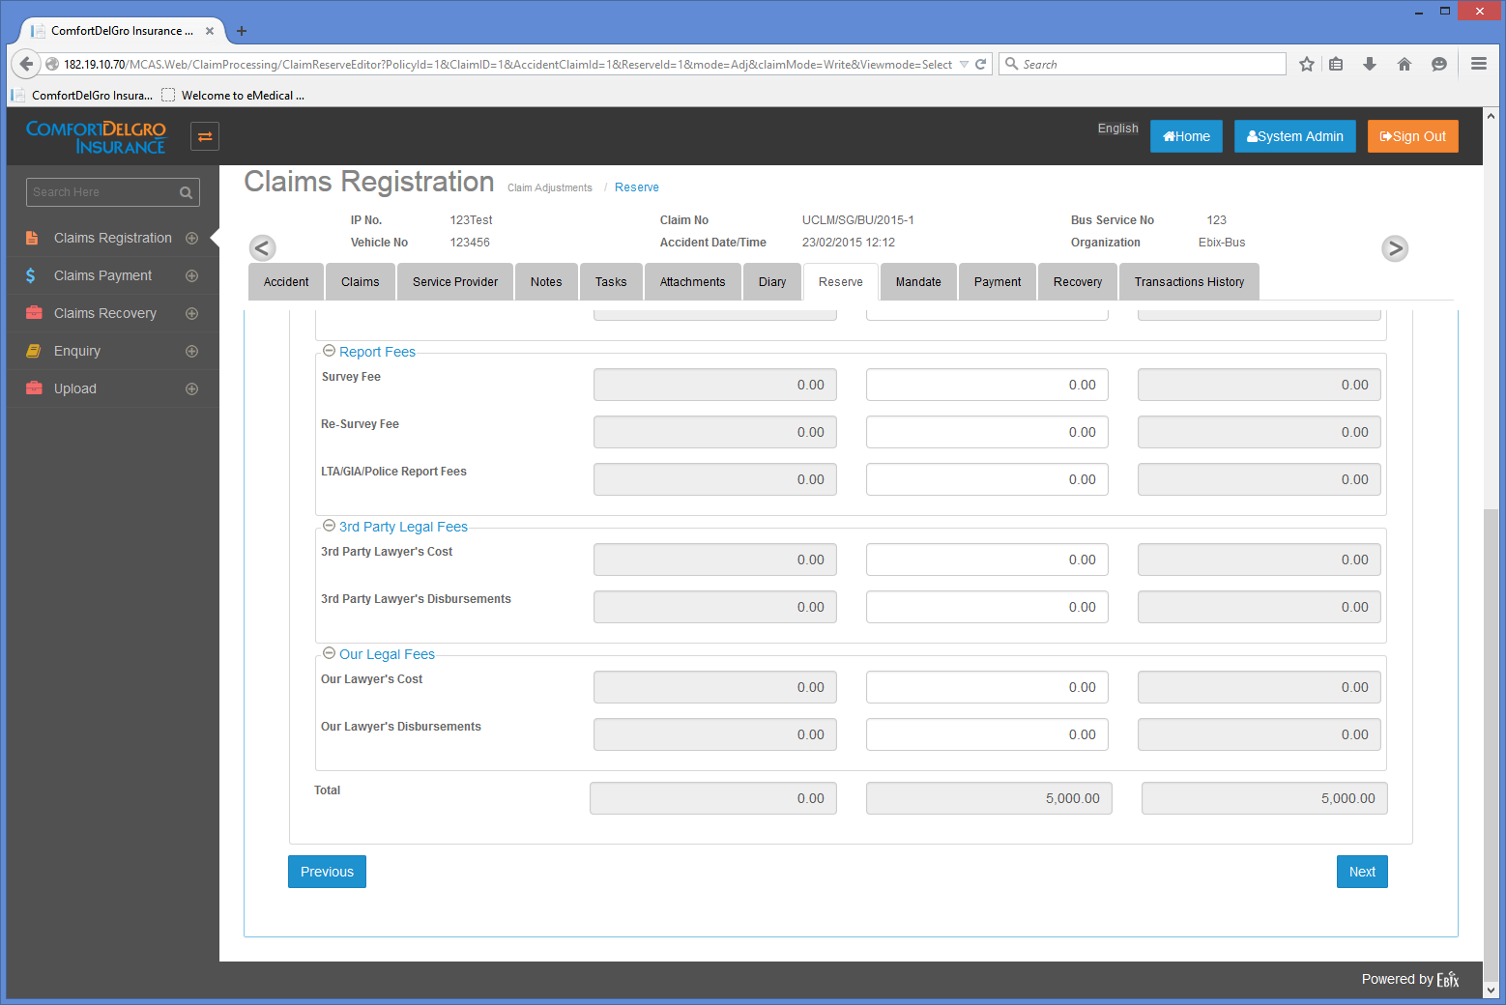

How Reserve Screen Works
Steps:
After Save is clicked. User can still input values in “Survey Fee” in Outstanding Reserve.
After clicking Save again. User can input values in the Reserve Movement to adjust the values in the Outstanding Reserve.
Note: Values in Outstanding Reserve Column will not change even when there’s values in the Reserve Movement.
Current Reserve Column will show the latest and updated value if there are input in reserve movement column
Once user clicks on Save. Current Reserve will show the updated value and Reserve Movement will be reset to 0. If there are new values in Outstanding Reserve, it will be blocked for editing. User’s inputs for Reserve Movement will also be captured in Reserve History.
After clicking Save, user can still continue to input values in Reserve Movement.
6000
-4000
2000
Opened for Editing
5000
3000
8000
11000
10000
6000
Reset to 0 and opened for editing for fields with value in Outstanding Reserve
2000
Opened for Editing
5000
8000

Slide 5
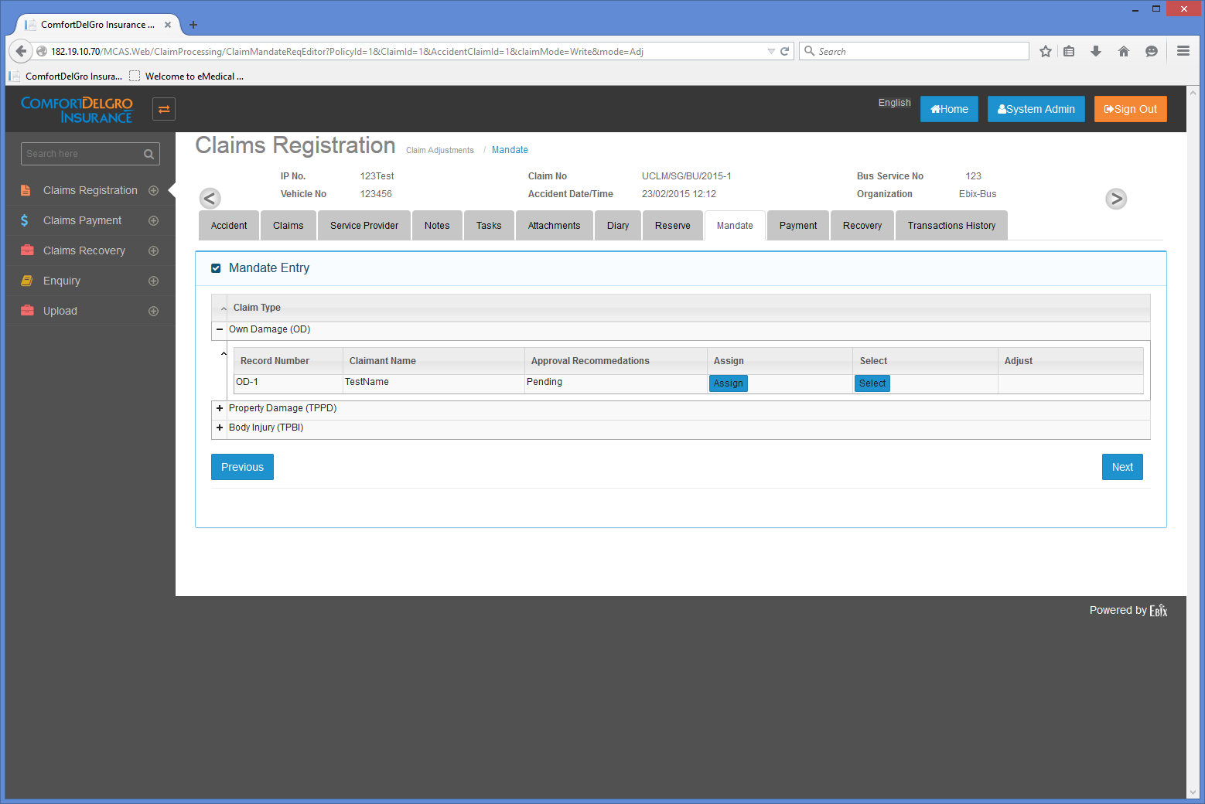
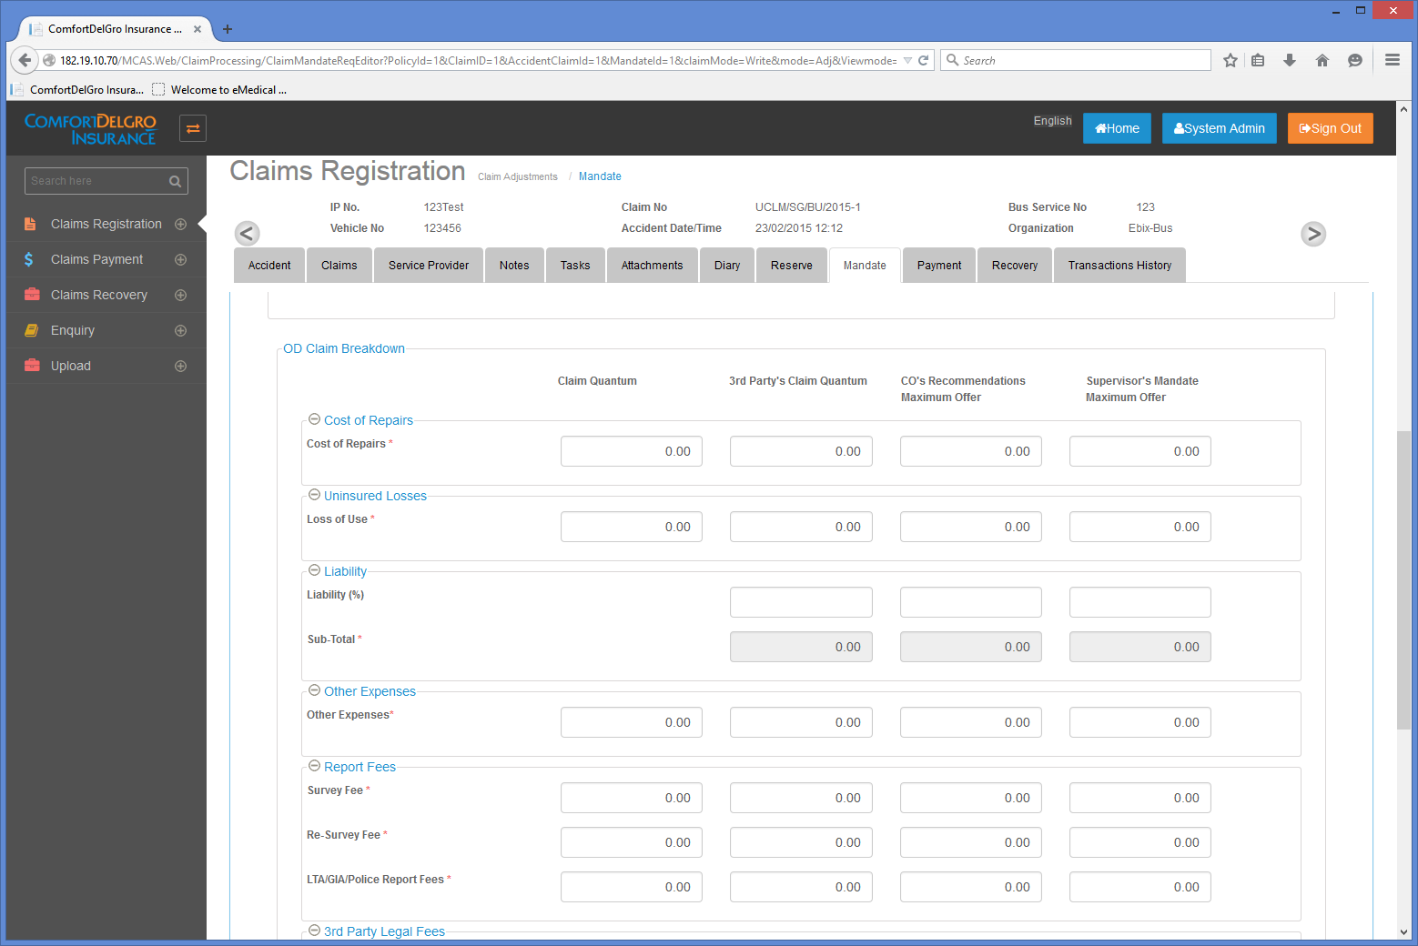
How Mandate Screen Works
Steps:
As long as user has input values in the Outstanding Reserve and has clicked Save Button. That Claim will flow to Mandate Screen.
User can create Multiple Mandate Requests for a Single Claim.
Changes Required:
Introduce +/- Here.
Remove Assign, Adjust Column
Change Select Button To Add Mandate Button
Click on Add Mandate Button will bring out the Mandate Screen for Relevant Claims
For OD: Populate Claim Quantum from Current Reserve Column. For PD & BI: Populate 3rd Party’s Claim Quantum from Current Reserve Column.
Not Save Function. Only Submit Button.
Once submitted, Mandate Reference is generated. Format is “MD-1” followed by “MD-2”. Each Claim Type will have its own “MD-” Running Number Series.
+/-
Add Mandate
OD: MD-1
MD-2
PD: MD-1
MD-2
Populate from Current Reserve.
No editing allowed.
Editable by Claim Officer
Only Editable by Assigned Supervisor. Not editable by Claim Officer or Support Staff
Submit

Slide 6
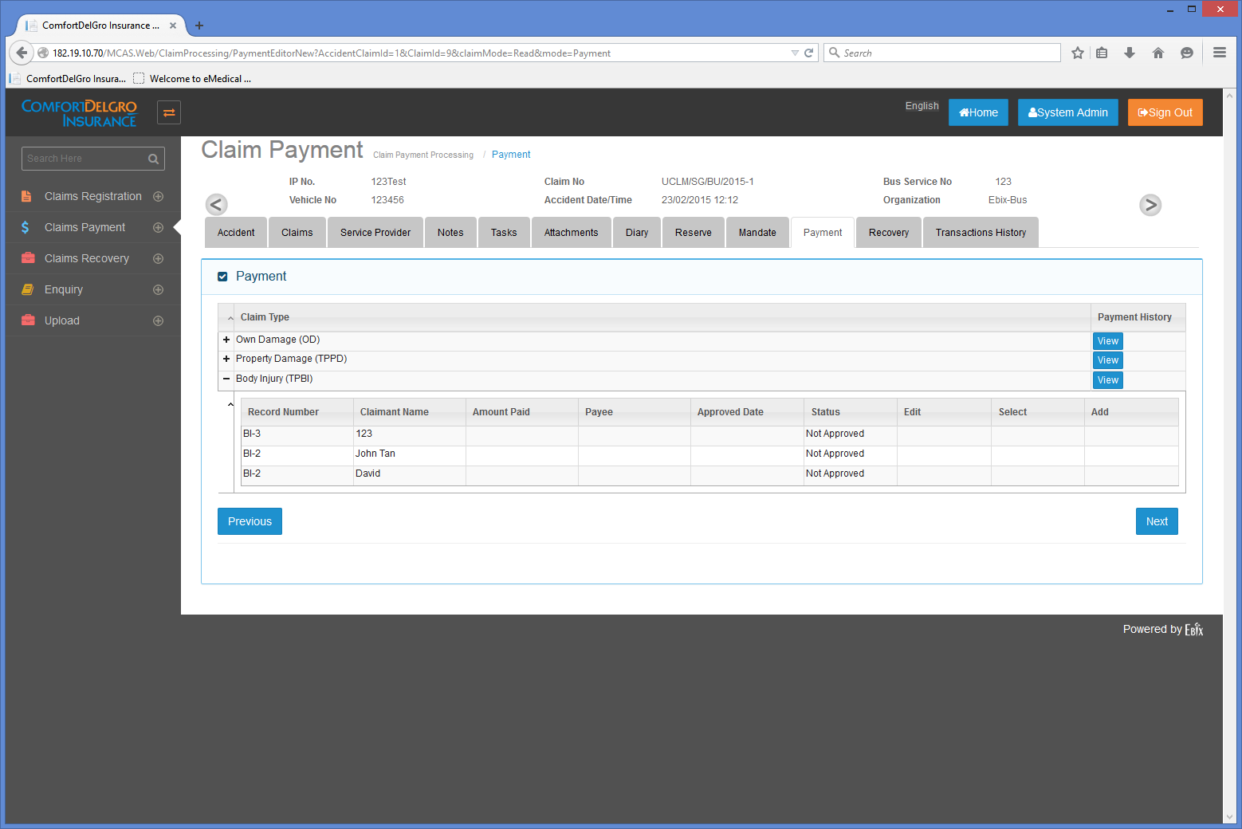
How Payment Screen Works
Steps:
When Supervisor has approved a Mandate Request. That Mandate Request will appear in the Claims Payment Menu for user to raise Payment Request.
User can create Multiple Payment Requests for a Single Approved Mandate.
Changes Required:
Introduce +/- for each Approved Mandate.
Include Add Payment Button
Click on Add Payment Button will bring out the Payment Screen for Relevant Claims
Outstanding From Developers:
Need to see the current Payment Screens for each Claim Type to finish this document. Current Mandate Screens do not have Submit Button.
Claim Flow Structure
(+/-) Own Damage
(+/-) -- OD-1
(+/-) --- MD-1 <<Add Payment Button>>
-----PMT-1
-----PMT-2
(+/-) --- MD-2 <<Add Payment Button>>
(+/-) Property Damage
(+/-) -- PD-1
(+/-) --- MD-1 <<Add Payment Button>>
(+/-) --- MD-2

